Slide 1
SOCIAL | SEM | DIGITAL DISPLAY + STREAMING OTT

Slide 2
AI-Driven, VIN-Specific Marketing Execution
We combine a real-time inventory database of over 10 million daily active VINs across the United States with machine learning and AI to produce dynamic, inventory-driven ad units across every digital channel.
We own a proprietary first-party audience of 4.5 million monthly active shoppers, representing the thin market of auto intenders ready to buy right now, and match those intenders directly to the inventory units they are most likely to purchase.
All campaigns deliver users directly to the dealer’s inventory pages (VDP/SRP), the most critical content to influence purchase behavior, and attribute results down to the VIN level for ultimate transparency to the dealer.
Our technology sets you apart.
The NordicAI platform paired with social media, digital dynamic display, reverse search, and OTT powered by starlink enables your dealers to spend less and turn cars faster.

Slide 3
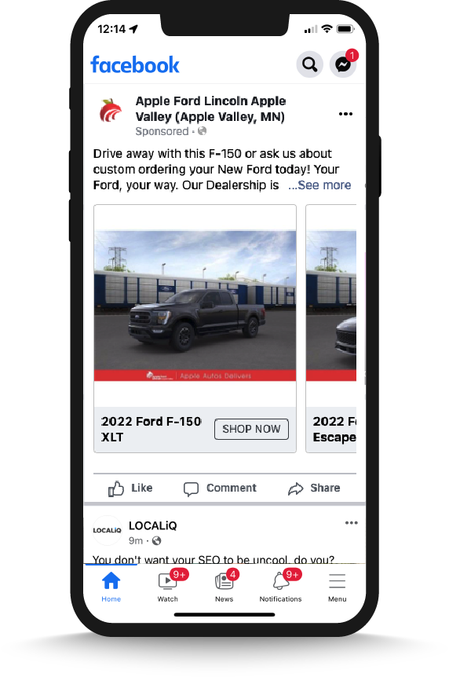
Dynamic, Inventory Based Ads
New and/or Used inventory currently available
at the dealership
Creative generated by the data contained in the VDP
Segment > Make > Model logic is prospecting, conquesting AND retargeting shoppers based on their shopping behavior
AI/ML Logic Sequencing via proprietary profiles is filtering the catalog of vehicles to focus on turn rate, take advantage of inventory positions AND maximize efficiency, constantly updating creative in real time

Slide 4
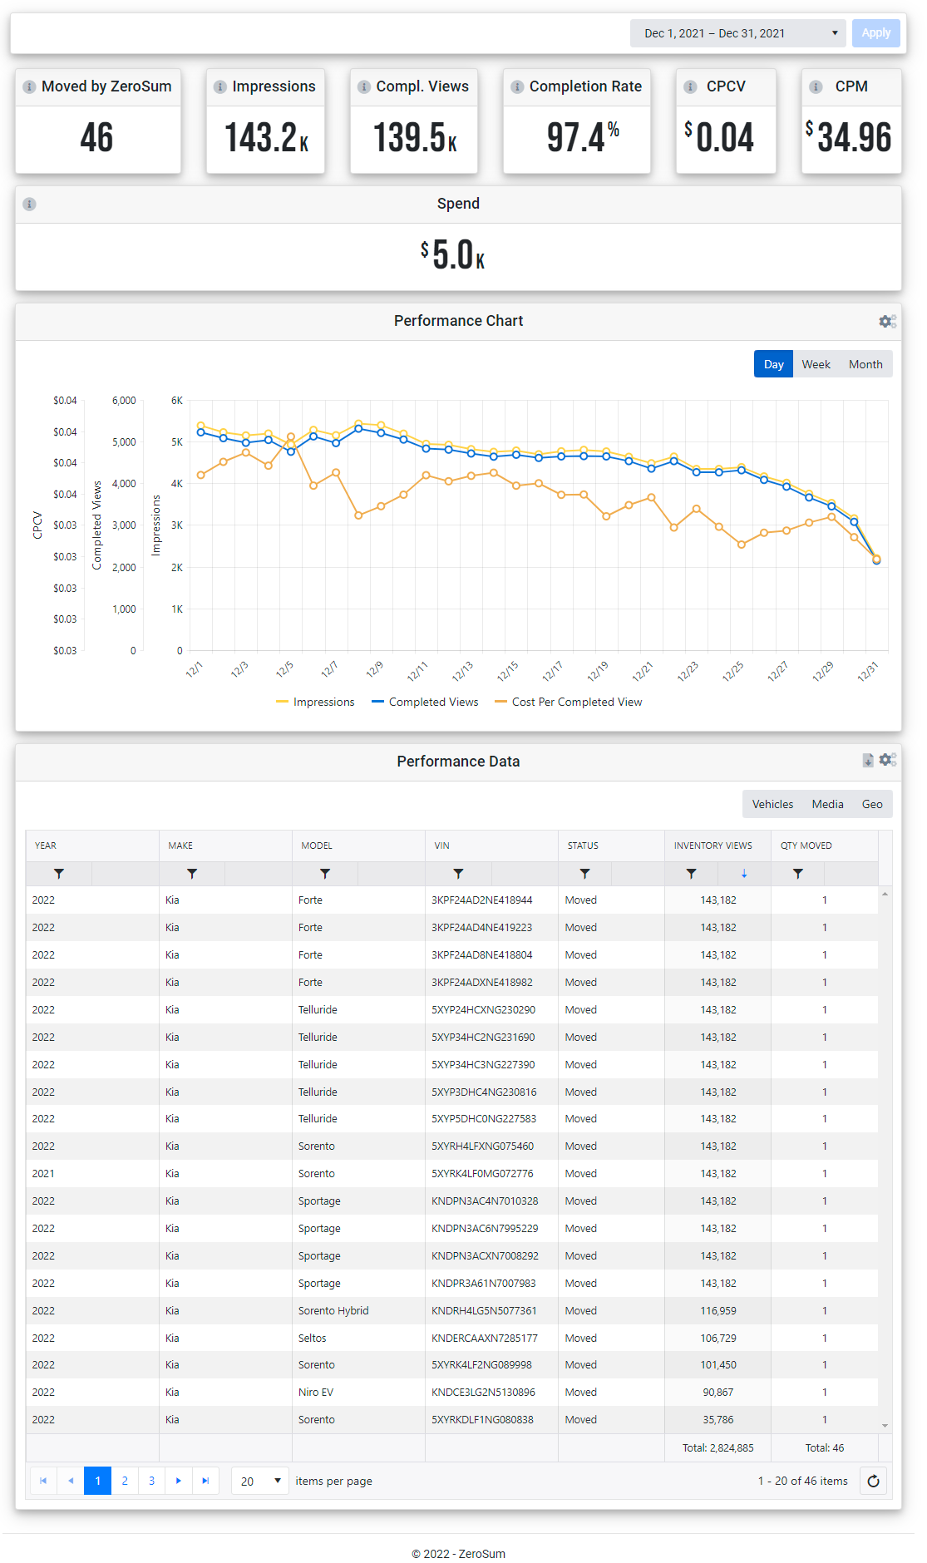
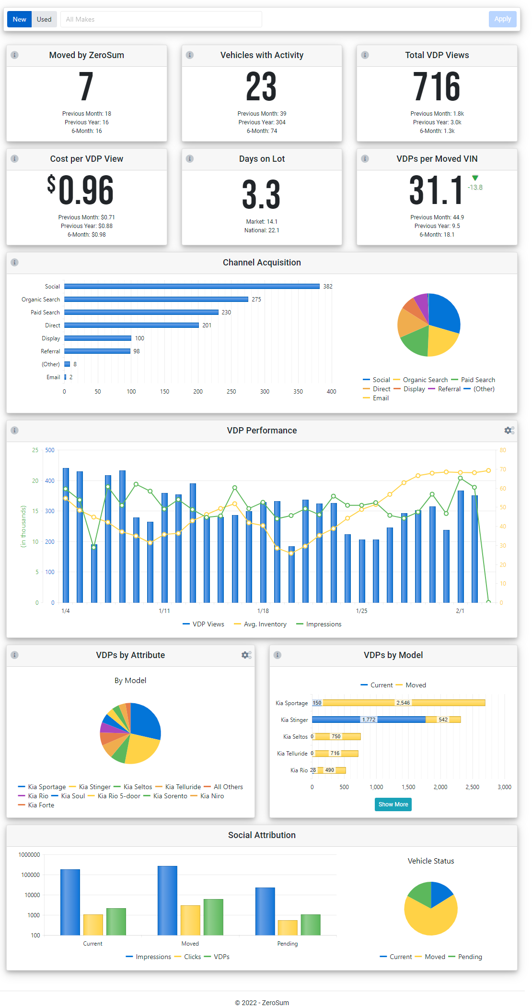
VIN Level Reporting & Attribution
Highly transparent reporting
Accountability to the VIN, and the VDP
Market leading insight
See how your marketing dollars affect the business

Slide 5
Social Media
Our Social Media solution includes inventory-based social ads delivered to active in-market shoppers.
NordicAI dynamically adjusts ad creative, spend, and delivery using proprietary algorithms to make the most impact possible with each impression served.
Social ads are delivered to our first-party audience built from people actively shopping cars in the last 15 days. This small window guarantees that you’re putting your dollars into qualified buyers.
You can see the impact on your business instantly in NordicAI with real-time performance metrics, exposing attribution to the VIN level as well as real time market share and sales goal pacing.

Slide 6
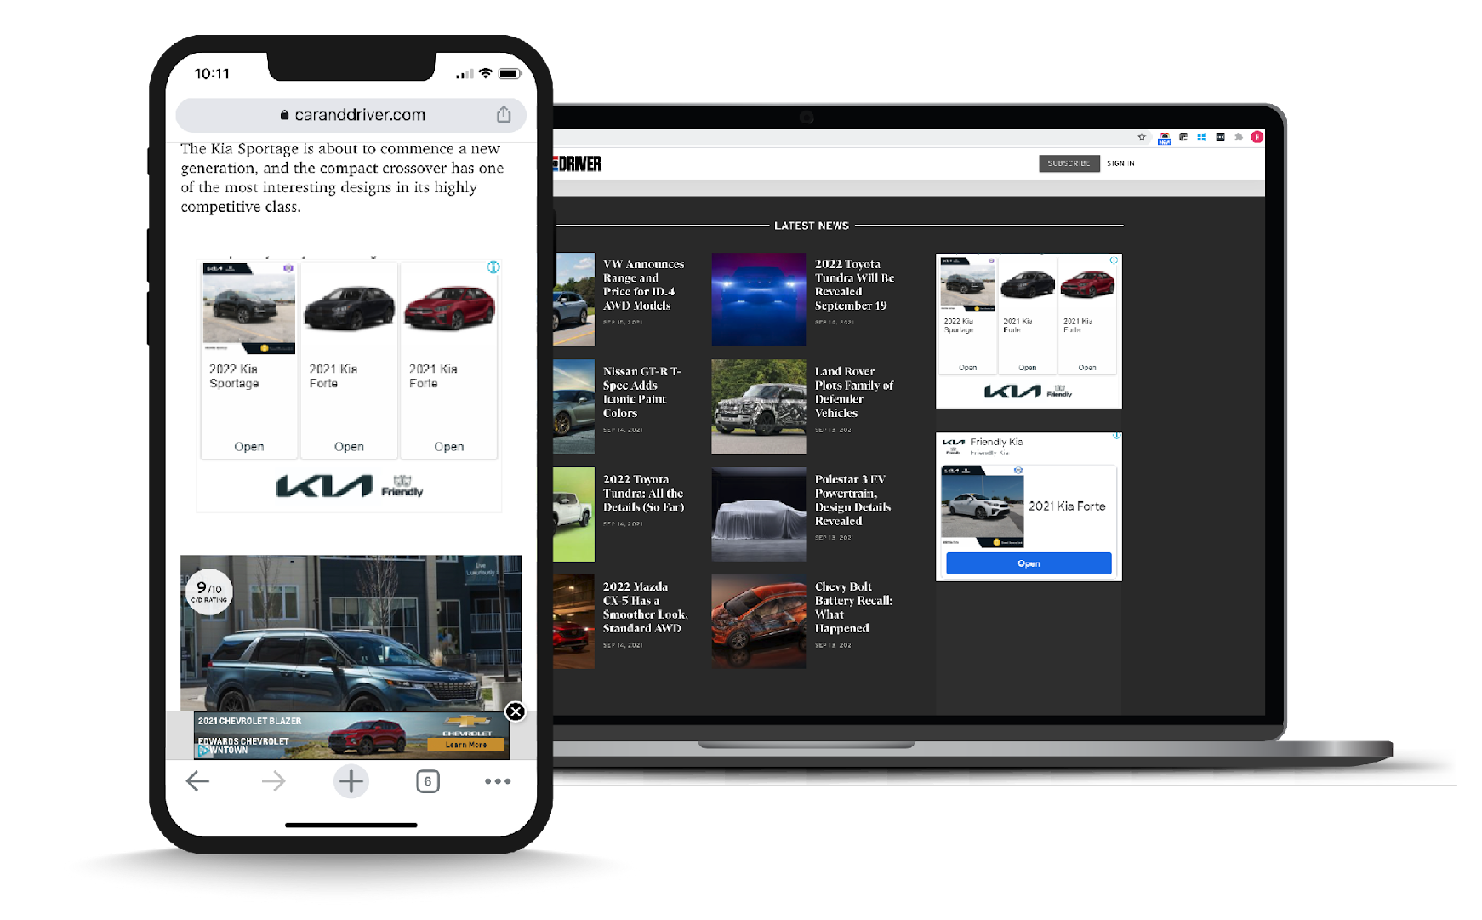
Dynamic Display
Precise Targeting Display ads are targeted to our proprietary audience matching dealer inventory to shopper activity across the web with display ads through NordicAI.
Dynamic Creative Creative is dynamically updated to show your current inventory, so no stale ads are delivered.
Accountable Results Transparent reporting is always available in the NordicAI platform next to your other marketing solutions along with key dealership performance and health indicators.

Slide 7
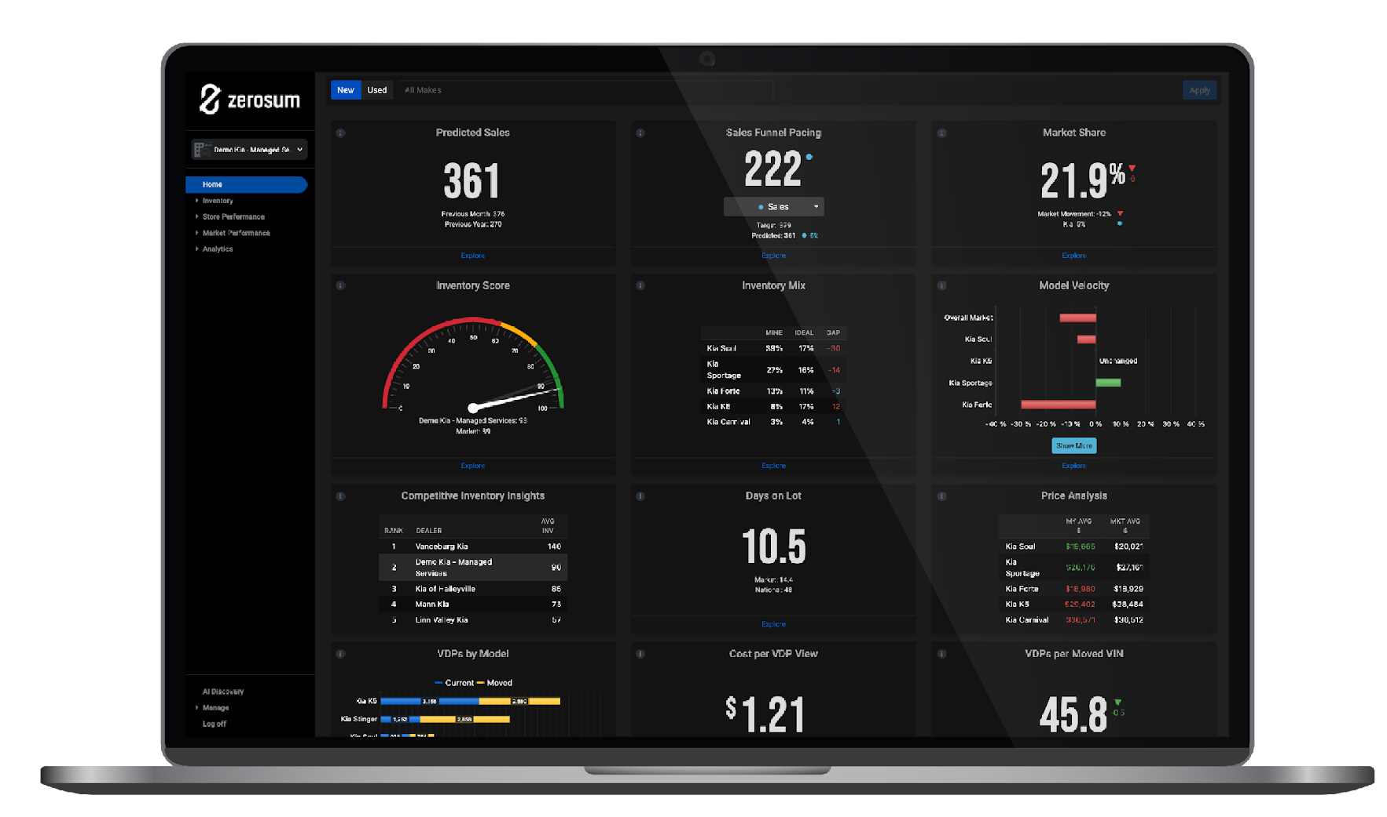
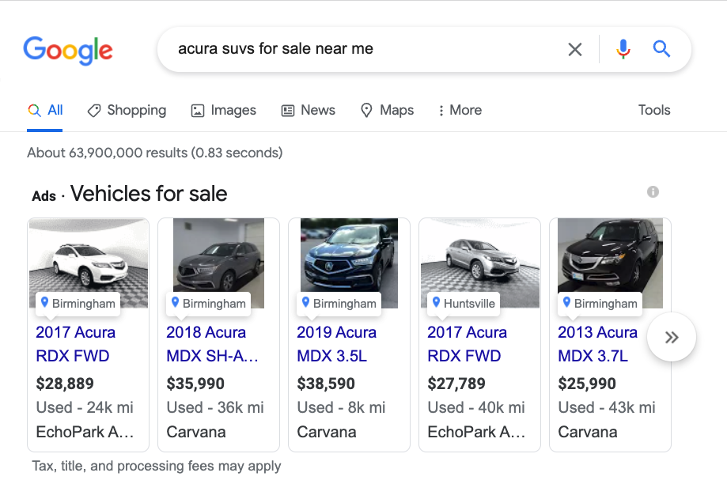
Shopping Ads
Vehicle Listing Ads place dealer inventory at the top of Google’s search results page when customers are searching for the used vehicles they have in stock.
These dynamically served ads feature details such as vehicle image, mileage, trim level, dealer name and location.
Using the data provided, Google automatically serves this ad type to identified shoppers who are using high intent search terms in our pre-identified geo. These terms can include make, model, year, trim, used, pre-owned, certified, and/or near me.
While Shopping is natural extension of search engine marketing, Shopping campaigns are served based onhigh-intent searches not keyword bids.
VEHICLE IMAGE​
VEHICLE LOCATION​
MAKE & MODEL​
PRICE​
VEHICLE MILEAGE​
ADVERTISER NAME

Slide 8
Search Engine Marketing
Show up when it matters. We focus our Search Engine Marketing (SEM) strategy on two important concepts.
The best clicks will be from people looking to buy a vehicle that is currently sitting on a dealer’s lot.
An impression is free meaning not every impression needs to be in the #1 spot to boost brand recognition.
NordicAI Reverse Search uses real-time, keyword-level automation to bid on the vehicles you have on your lot.
These constant adjustments eliminate wasted spend by ensuring that your dynamic search campaigns are always up-to-date.
That same inventory data is also used to create compelling ad copy that draws in buyers by showing inventory attributes like number in stock or the lowest price offered.

Slide 9
The world’s only high-performance OTT/CTV advertising platform for auto marketers.
At the push of a button.
Live Inventory Integration The Nordic-Stream platform integrates live inventory to create, target, and deliver VIN-specific ads seamlessly.
Speed to market Get up and running in less than 48 hours.
No Production Costs Eliminate the high cost of production with our proprietary technology that uses AI to build individual commercials for each VIN, complete with professional-sounding voiceovers and integrated OEM brand standards.
Active Shoppers We target active auto buyers who are in market to purchase the vehicles you have on your lot right now, in the next 14 days.
Accountability Nordic-Stream provides what no one else can–VIN-level attribution for video.
Notes:
The VDPs you need to turn the vehicles
Engage with In-Market Shoppers, no matter where they are
Maximize reach without the spend of traditional TV
Realign budget with current shopping behavior
Fill the funnel with qualified buyers
Connect media dollars with moved units – VIN Level attribution
Better utilization of marketing dollars
Maximize Co-op funds

